Slide 1
Chapter 2: Static Routing
Instructor Materials
CCNA Routing and Switching
Routing and Switching Essentials v6.0
Notes:
Cisco Networking Academy Program
Routing and Switching Essentials v6.0
Chapter 2: Static Routing

Slide 2
Instructor Materials – Chapter 2 Planning Guide
This PowerPoint deck is divided in two parts:
Instructor Planning Guide
Information to help you become familiar with the chapter
Teaching aids
Instructor Class Presentation
Optional slides that you can use in the classroom
Begins on slide # 12
Note: Remove the Planning Guide from this presentation before sharing with anyone.
Notes:
2

Slide 3
Chapter 2: Static Routing
Routing and Switching Essentials 6.0 Planning Guide
Notes:
Cisco Networking Academy Program
Routing & Switching Essentials v6.0
Chapter 2: Static Routing

Slide 4
Chapter 2: Activities
What activities are associated with this chapter?
Page # | Activity Type | Activity Name | Optional?
2.0.1.2 | Class Activity | Which Way Should We Go | Optional
2.1.1.4 | Interactive Activity | Identify the Advantages and Disadvantages of Static Routing | Recommended
2.1.2.6 | Interactive Activity | Identify the Type of Static Route | Recommended
2.2.1.3 | Syntax Checker | Configure a Next-Hop Static Route | Recommended
2.2.1.4 | Syntax Checker | Configure a Directly Connected Static Route | Recommended
2.2.1.5 | Syntax Checker | Configure a Fully Specified Static Route | Recommended
2.2.1.6 | Syntax Checker | Verify the Static Routing Settings | Recommended
2.2.2.4 | Packet Tracer | Configuring IPv4 Static and Default Routes | Recommended
2.2.2.5 | Lab | Configuring IPv4 Static and Default Routes | Recommended
2.2.3.1 | Syntax Checker | Enabling IPv6 Unicast Routing | Recommended
The password used in the Packet Tracer activities in this chapter is: PT_ccna5
Notes:
4

Slide 5
Chapter 2: Activities
What activities are associated with this chapter?
Page # | Activity Type | Activity Name | Optional?
2.2.3.3 | Syntax Checker | Configure Next-Hop Static IPv6 Routes | Recommended
2.2.3.4 | Syntax Checker | Configure a Directly Connected Static IPv6 Route | Recommended
2.2.3.5 | Syntax Checker | Configure a Fully Specified Static IPv6 Route | Recommended
2.2.4.4 | Packet Tracer | Configuring IPv6 Static and Default Routes | Recommended
2.2.4.5 | Lab | Configuring IPv6 Static and Default Routes | Recommended
2.2.5.2 | Syntax Checker | Configure a Floating Static Route | Recommended
2.2.5.5 | Packet Tracer | Configuring Floating Static Routes | Recommended
2.2.6.2 | Syntax Checker | Configure IPv4 and IPv6 Static Host Routes | Recommended
2.3.2.3 | Packet Tracer | Troubleshooting Static Routes | Recommended
The password used in the Packet Tracer activities in this chapter is: PT_ccna5
Notes:
5

Slide 6
Chapter 2: Activities
What activities are associated with this chapter?
Page # | Activity Type | Activity Name | Optional?
2.3.2.4 | Lab | Troubleshooting Static Routes | Recommended
2.4.1.1 | Class Activity | Make It Static | Optional
The password used in the Packet Tracer activities in this chapter is: PT_ccna5
Notes:
6

Slide 7
Chapter 2: Assessment
Students should complete Chapter 2, “Assessment” after completing Chapter 2.
Quizzes, labs, Packet Tracers and other activities can be used to informally assess student progress.
Notes:
7

Slide 8
Chapter 2: Best Practices
Prior to teaching Chapter 2, the instructor should:
Complete Chapter 2, “Assessment.”
The objectives of this chapter are:
Explain advantages and disadvantages of static routing.
Explain the purpose of different types of static routes.
Configure IPv4 static routes by specifying a next-hop address.
Configure an IPv4 default route.
Configure IPv6 static routes by specifying a next-hop address.
Configure an IPv6 default route.
Configure a floating static route to provide a backup connection.
Configure IPv4 and IPv6 static host routes that direct traffic to a specific host.
Explain how a router processes packets when a static route is configured.
Troubleshoot common static and default route configuration issues.
Notes:
8

Slide 9
Chapter 2: Best Practices (Cont.)
Ensure this chapter becomes as hands-on as possible.
Create a pre-configured Packet Tracer with multiple routers and LANs to use for demonstration throughout the chapter.
Demonstrate that a workstation cannot ping another remote network without routing.
Demonstrate show ip route with and without static routing.
Demonstrate a floating static backup route using both the ping and trace route commands.
Stress the advantages of static routing. It is easy for students to discount static routing in favor of dynamic.
Create multiple topologies to demonstrate the next hop verses the exit interface method of creating a static route.
Encourage students to address all the interfaces in a topology and immediately check for connected networks with the show ip route command before configuring static routing.
Notes:
9

Slide 10
Chapter 2: Additional Help
For additional help with teaching strategies, including lesson plans, analogies for difficult concepts, and discussion topics, visit the CCNA Community at: https://www.netacad.com/group/communities/community-home
Best practices from around the world for teaching CCNA Routing and Switching. https://www.netacad.com/group/communities/ccna
If you have lesson plans or resources that you would like to share, upload them to the CCNA Community in order to help other instructors.
Students can enroll in Introduction to Packet Tracer (self-paced).
Notes:
10

Slide 12
Chapter 2: Static Routing
CCNA Routing and Switching
Routing and Switching Essentials v6.0
Notes:
Cisco Networking Academy Program
Routing and Switching Essentials v6.0
Chapter 2: Static Routing

Slide 13
Chapter 2 - Sections & Objectives
2.1 Static Routing Advantages
Explain how static routes are implemented in a small to medium-sized business network.
Explain advantages and disadvantages of static routing.
Explain the purpose of different types of static routes.
2.2 Configure Static and Default Routes
Configure static routes to enable connectivity in a small to medium-sized business network.
Configure IPv4 static routes by specifying a next-hop address.
Configure an IPv4 default route.
Configure IPv6 static routes by specifying a next-hop address.
Configure an IPv6 default route.
Configure a floating static route to provide a backup connection.
Configure IPv4 and IPv6 static host routes that direct traffic to a specific host.
Notes:
13
Cisco Networking Academy Program
Routing and Switching Essentials v6.0
Chapter 2: Static Routing

Slide 14
Chapter 2 - Sections & Objectives (Cont.)
2.3 Troubleshoot Static and Default Routes
Given an IP addressing scheme, configure IP address parameters on devices to provide end-to-end connectivity in a small to medium-sized business network.
Explain how a router processes packets when a static route is configured.
Troubleshoot common static and default route configuration issues.
Notes:
14
Cisco Networking Academy Program
Routing and Switching Essentials v6.0
Chapter 2: Static Routing

Slide 15
2.1 Implement Static Routes
Notes:
2 - Static Routing
2.1 – Implement Static Routes

Slide 16
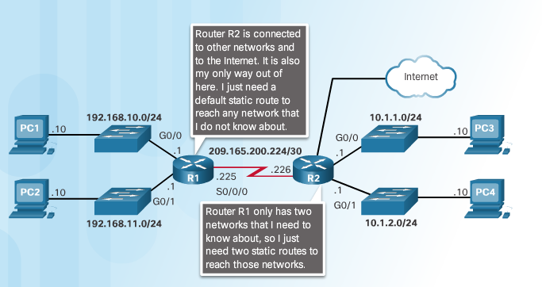
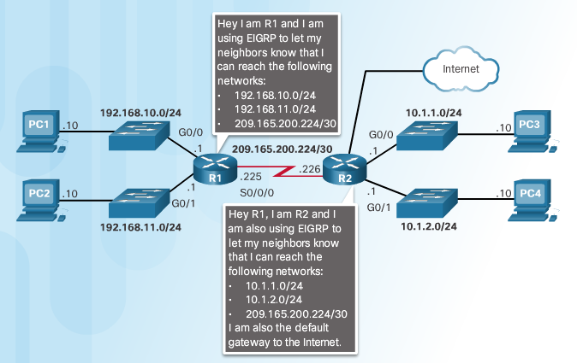
Static Routing Reach Remote Networks
A router learns about remote networks in two ways:
Manually entered into the route table using static routes
Static routes are not automatically updated and must be reconfigured when topology changes
Dynamically (Automatically) learned using a routing protocol
Static and Default Routes
Dynamic Routing
Notes:
2.1 – Implement Static Routes
2.1.1 – Static Routing
2.1.1.1 – Reach Remote Networks

Slide 17
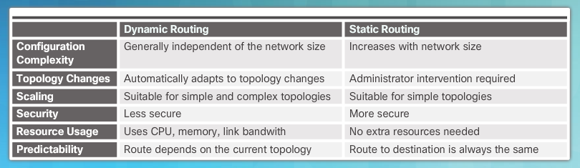
Static Routing Why Use Static Routing?
Dynamic versus Static Routing
Notes:
2.1 – Implement Static Routes
2.1.1 – Static Routing
2.1.1.2 – Why Use Static Routing?

Slide 18
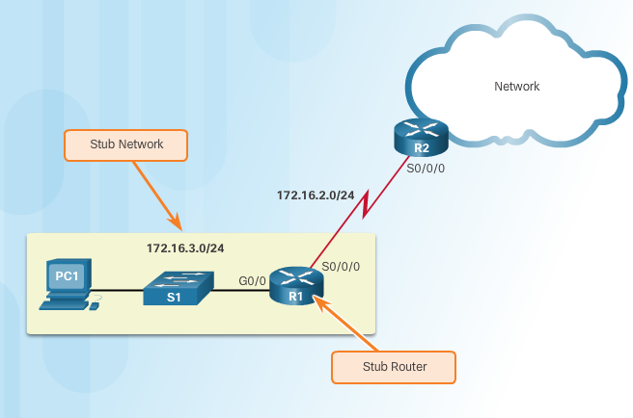
Static Routing When to Use Static Routes
Three uses for static routes:
Smaller networks that are not expected to grow
Routing to and from stub networks
Stub network accessed by a single route and has one neighbor
172.16.3.0 is a stub network
A single default route to represent a path to any network not found in the routing table
Use default route on R1 to point to R2 for all other networks
Stub Networks and Stub Routers
Notes:
2.1 – Implement Static Routes
2.1.1 – Static Routing
2.1.1.3 – When to Use Static Routes

Slide 19
Types of Static Routes Static Route Applications
Use Static Routes To:
Connect to a specific network
Connect a stub router
Summarize routing table entries which reduces size of routing advertisements
Create a backup route in case a primary route link fails
Notes:
2.1 – Implement Static Routes
2.1.2 – Types of Static Routes
2.1.2.1 – Static Route Applications

Slide 20
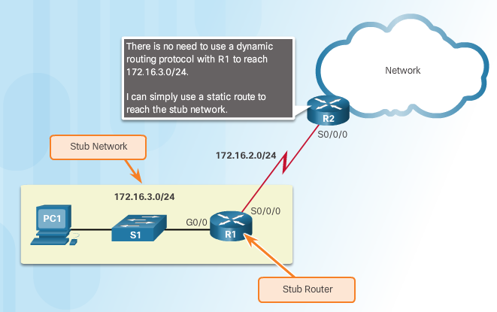
Types of Static Routes Standard Static Route
R2 configured with a static route to reach the stub network 172.16.3.0/24
Notes:
2.1 – Implement Static Routes
2.1.2 – Types of Static Routes
2.1.2.2 – Standard Static Route

Slide 21
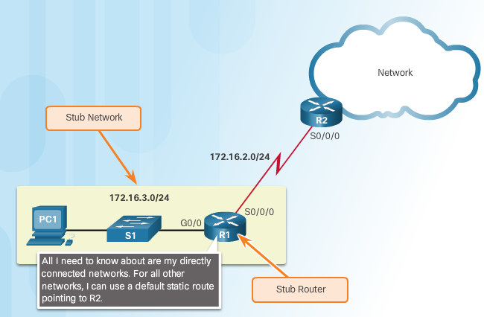
Types of Static Routes Default Static Route
Default route matches all packets and is used when a packet does not match a specific route in the routing table
Can be dynamically learned or statically configured
Default Static route uses 0.0.0.0/0 as the destination IPv4 address
Creates a Gateway of Last Resort
Common use is when connecting a company’s edge router to the ISP network
Router has only one router to which it is connected
Notes:
2.1 – Implement Static Routes
2.1.2 – Types of Static Routes
2.1.2.3 – Default Static Route

Slide 22
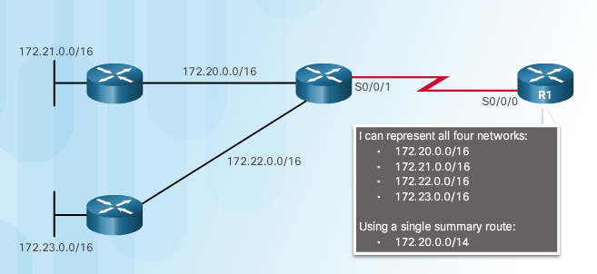
Types of Static Routes Summary Static Route
Multiple static routes can be summarized into a single network address
Destination networks must be contiguous
Multiple static routes must use the same exit interface or next hop
In figure, four networks is summarized into one summary static route
Notes:
2.1 – Implement Static Routes
2.1.2 – Types of Static Routes
2.1.2.4 – Summary Static Route

Slide 23
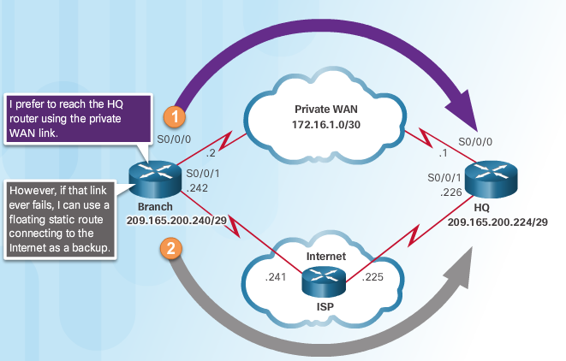
Types of Static Routes Floating Static Route
Static routes that are used to provide a backup path
Used when primary route is not available
Configured with a higher administrative distance (trustworthiness) than the primary route
Example: EIGRP administrative distance equals 90. A floating static route with an AD of 91 or higher would serve as backup route and will be used if EIGRP route goes down.
Floating Static Route
Notes:
2.1 – Implement Static Routes
2.1.2 – Types of Static Routes
2.1.2.5 – Floating Static Route

Slide 24
2.2 Configure Static and Default Routes
Notes:
2 - Static Routing
2.2 – Configure Static and Default Routes

Slide 25
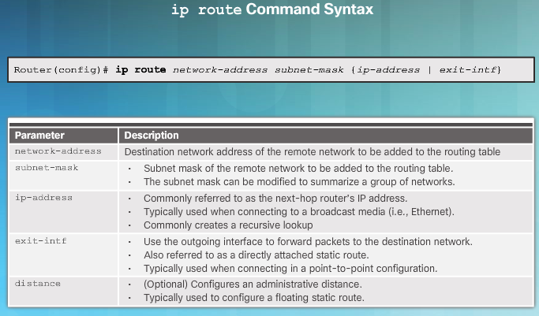
Configure IPv4 Static Routes ip route Command
Notes:
2.2 – Configure Static and Default Routes
2.2.1 – Configure IPv4 Static Routes
2.2.1.1 –ip route Command

Slide 26
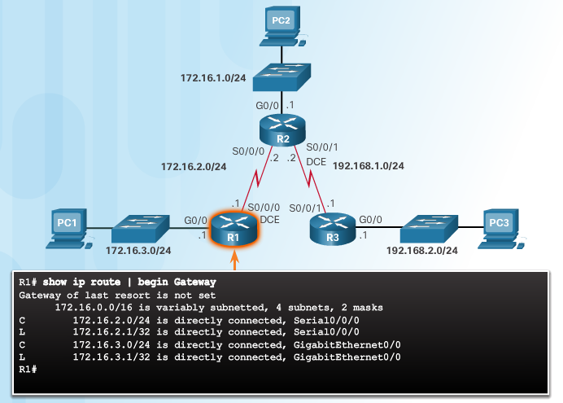
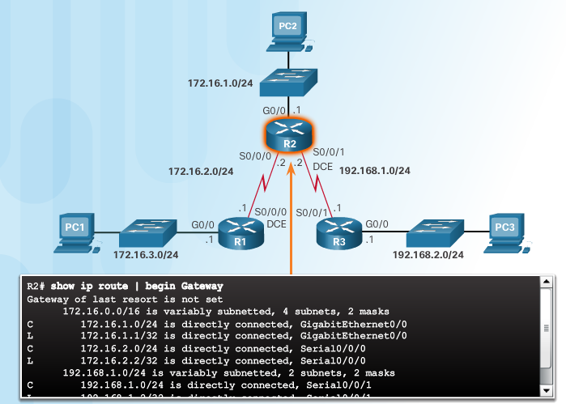
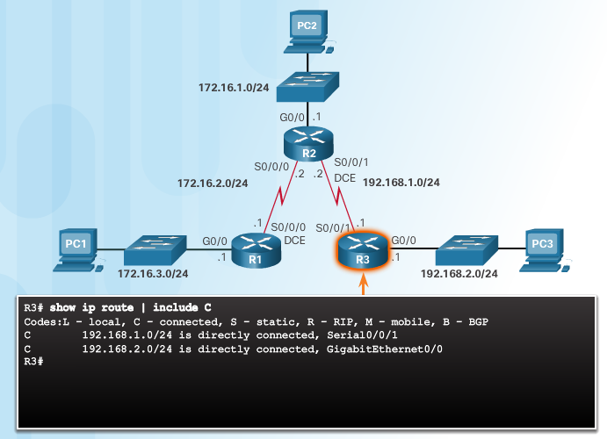
Configure IPv4 Static Routes Next-Hop Options
In this example, each router only has entries for directly connected network
Notes:
2.2 – Configure Static and Default Routes
2.2.1 – Configure IPv4 Static Routes
2.2.1.2 – Next-Hop Options

Slide 27
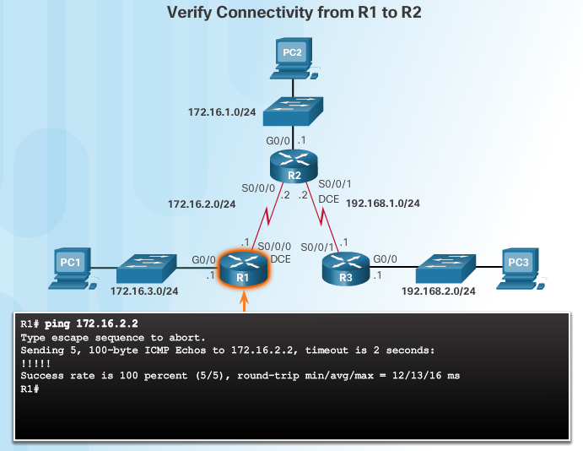
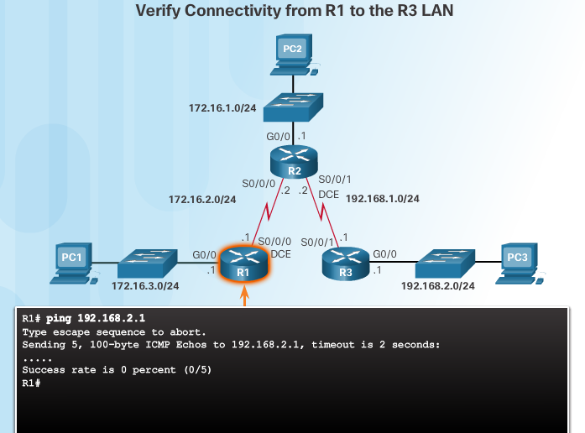
Configure IPv4 Static Routes Next-Hop Options (Cont.)
R1 does not have an entry in its routing table for the R3 LAN network
In a static route next-hop can be identified by
Next-hop IP address
Router exit interface
Next-hop IP address and exit interface
Notes:
2.2 – Configure Static and Default Routes
2.2.1 – Configure IPv4 Static Routes
2.2.1.2 – Next-Hop Options

Slide 28
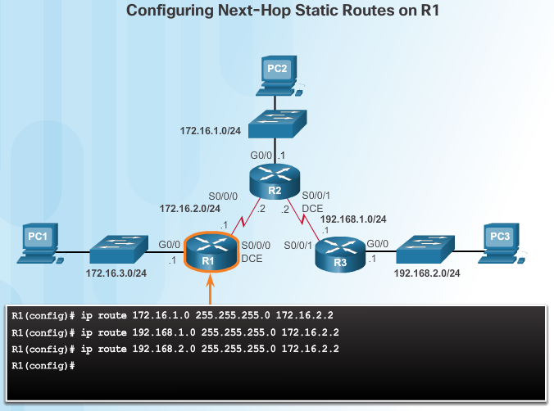
Configure IPv4 Static Routes Configure a Next-Hop Static Route
In this example, only the next-hop IP address is specified
Before packet is forwarded the router must determine the exit interface to use (route resolvability)
Notes:
2.2 – Configure Static and Default Routes
2.2.1 – Configure IPv4 Static Routes
2.2.1.3 – Configure a Next-Hop Static Route

Slide 29
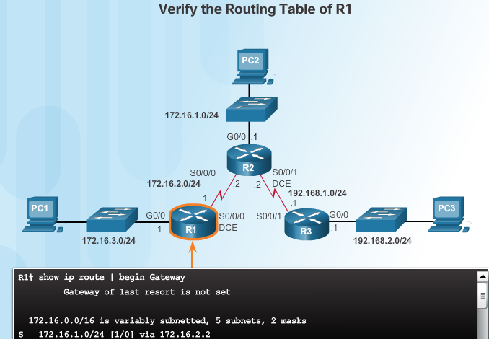
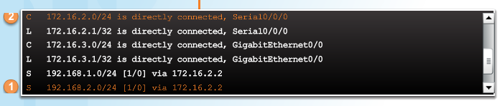
Configure IPv4 Static Routes Configure a Next-Hop Static Route (Cont.)
In example, when a packet is destined for 192.168.2.0/24 network, R1:
Looks for match (#1) and needs to forward packets to 172.16.2.2
R1 must determine how to reach 172.16.2.2 first
Searches a second time for 172.16.2.0/24 (#2) and matches to exit interface s0/0/0
Takes two routing table lookups, process referred to as recursive lookup
If the exit interface is “down” or “administratively down” then the static route configured with next-hop will not be installed in routing table
Notes:
2.2 – Configure Static and Default Routes
2.2.1 – Configure IPv4 Static Routes
2.2.1.3 – Configure a Next-Hop Static Route

Slide 30
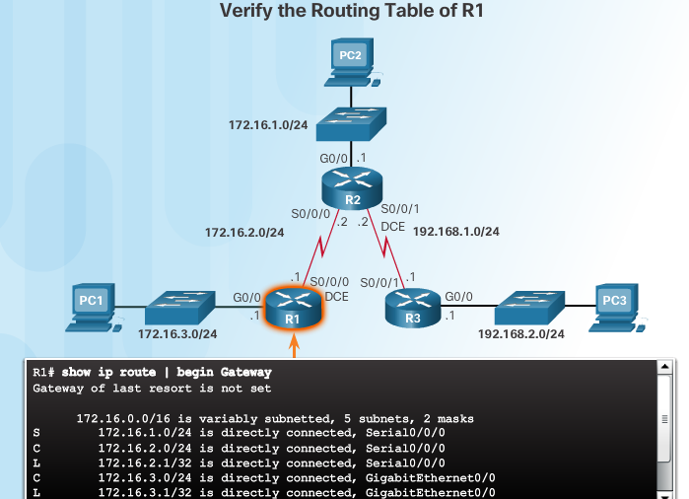
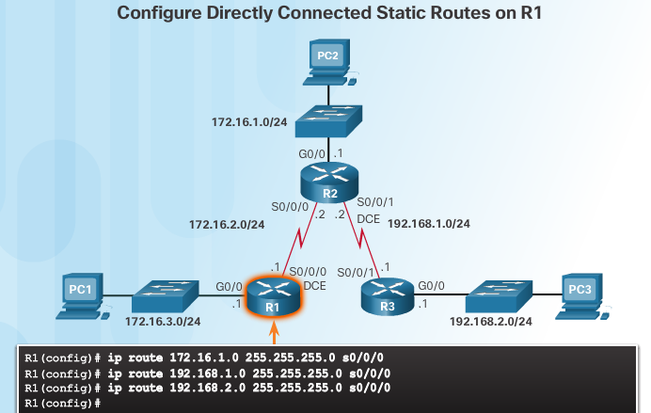
Configure IPv4 Static Routes Configure a Directly Connected Static Route
Use the exit interface to specify next-hop so no other lookups are required
Administrative distance of static route is 1
Notes:
2.2 – Configure Static and Default Routes
2.2.1 – Configure IPv4 Static Routes
2.2.1.4 – Configure a Directly Connected Static Route

Slide 31
Configure IPv4 Static Routes Configure a Directly Connected Static Route (Cont.)
Cisco Express Forwarding (CEF)
default behavior on IOS 12.0 or later
provides optimized lookup
uses a Forwarding Information Base (FIB) which is a copy of the routing table and an adjacency table that includes Layer 2 addresses
no recursive lookup needed for next-hop IP address lookups
Notes:
2.2 – Configure Static and Default Routes
2.2.1 – Configure IPv4 Static Routes
2.2.1.4 – Configure a Directly Connected Static Route

Slide 32
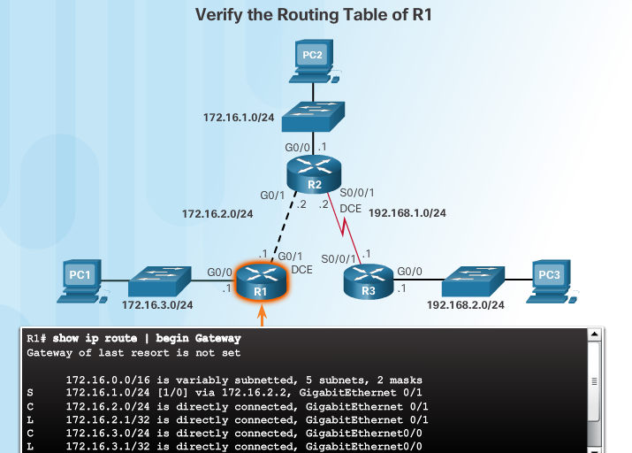
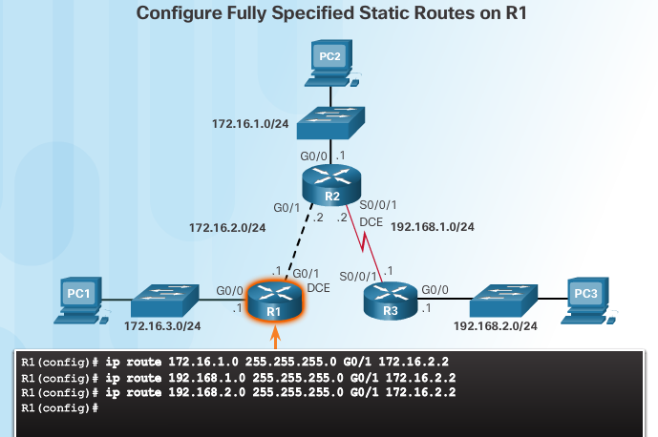
Configure IPv4 Static Routes Configure a Fully Specified Static Route
Both the exit interface and the next-hop IP address are specified
When exit interface is an Ethernet network, fully specified static route is used
Note: With CEF, a next-hop address could be used instead
Notes:
2.2 – Configure Static and Default Routes
2.2.1 – Configure IPv4 Static Routes
2.2.1.5 – Configure a Fully Specified Static Route

Slide 33
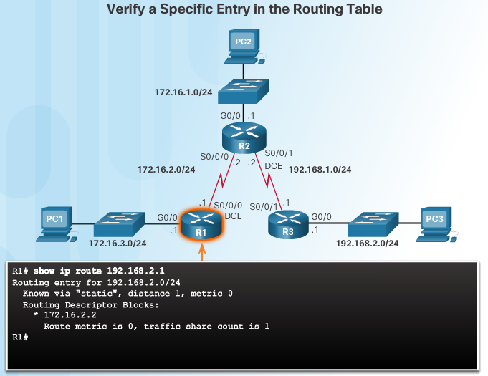
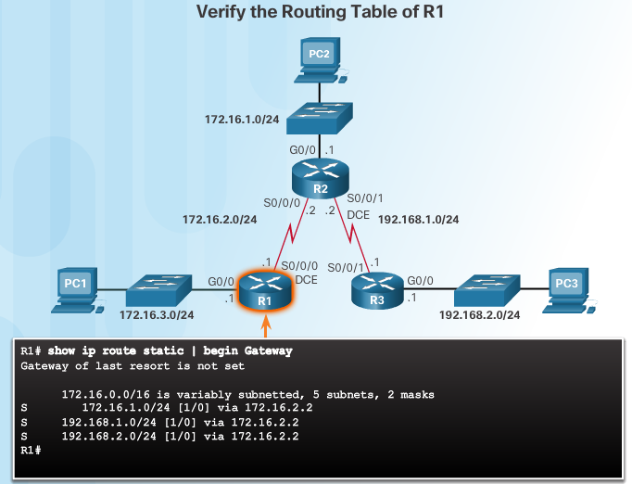
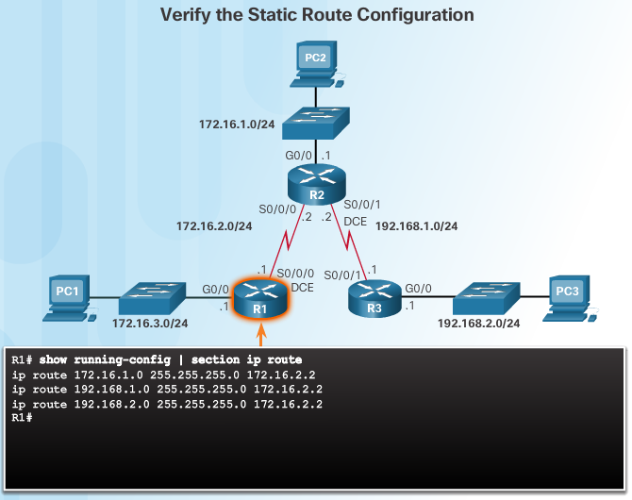
Configure IPv4 Static Routes Verify a Static Route
Notes:
2.2 – Configure Static and Default Routes
2.2.1 – Configure IPv4 Static Routes
2.2.1.6 – Verify a Static Route

Slide 34
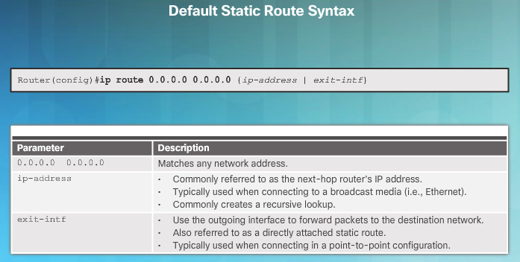
Configure IPv4 Default Routes Default Static Route
Default static routes are commonly used when connecting:
An edge router to a service provider network
A stub router (a router with only one upstream neighbor router)
Default route is used when no other routes in the routing table match the destination IP
Notes:
2.2 – Configure Static and Default Routes
2.2.2 – Configure IPv4 Default Routes
2.2.2.1 – Default Static Route

Slide 35
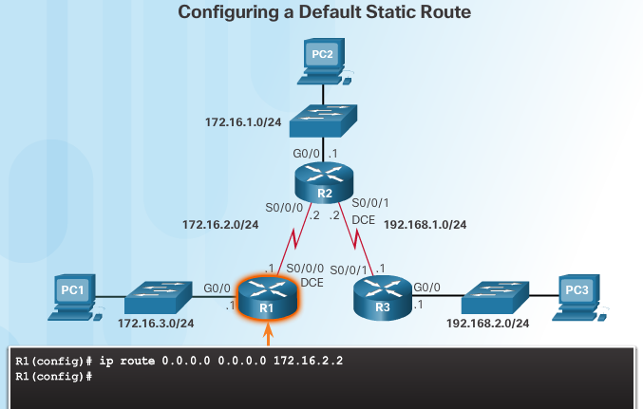
Configure IPv4 Default Routes Configure a Default Static Route
Any packets not matching route entries are forwarded to 172.16.2.2
Notes:
2.2 – Configure Static and Default Routes
2.2.2 – Configure IPv4 Default Routes
2.2.2.2 – Configure a Default Static Route

Slide 36
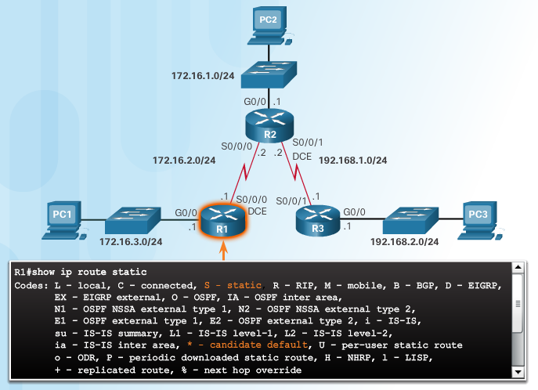

Configure IPv4 Default Routes Verify a Default Static Route
show ip route static displays just the static routes
S indicates static route
candidate default route indicated by *
/0 mask in route entry indicates none of the bits are required to match
Notes:
2.2 – Configure Static and Default Routes
2.2.2 – Configure IPv4 Default Routes
2.2.2.3 – Verify a Default Static Route

Slide 37
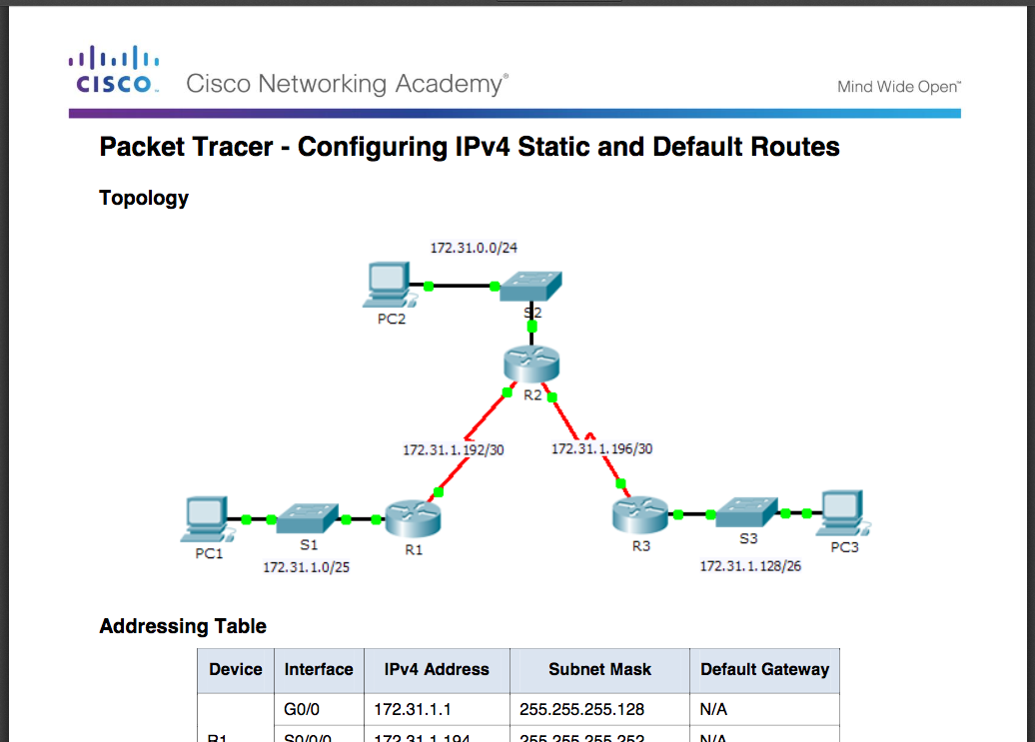
Configure IPv4 Default Routes Packet Tracer – Configuring IPv4 Static and Default Routes
Notes:
2.2 – Configure Static and Default Routes
2.2.2 – Configure IPv4 Default Routes
2.2.2.4 – Packet Tracer – Configuring IPv4 Static and Default Routes

Slide 38
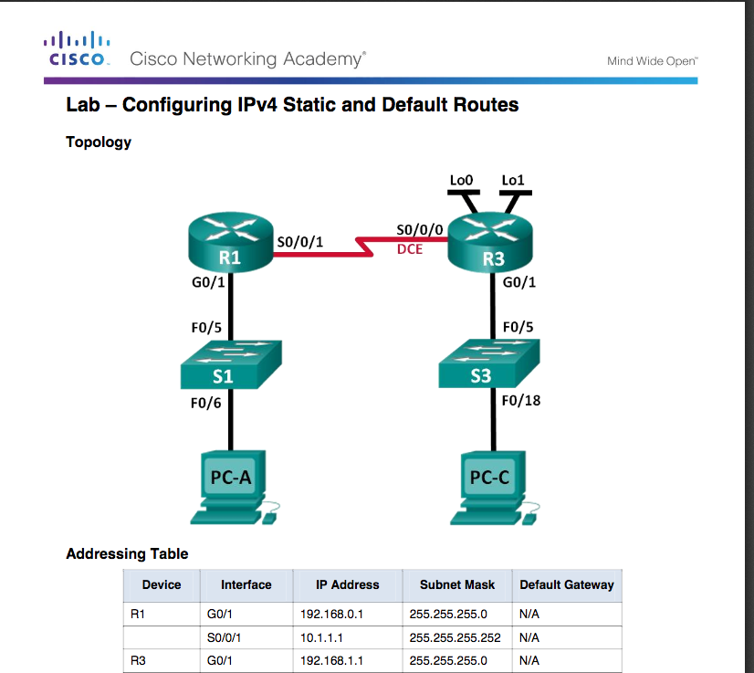
Configure IPv4 Default Routes Lab – Configuring IPv4 Static and Default Routes
Notes:
2.2 – Configure Static and Default Routes
2.2.2 – Configure IPv4 Default Routes
2.2.2.5 – Lab– Configuring IPv4 Static and Default Routes

Slide 39
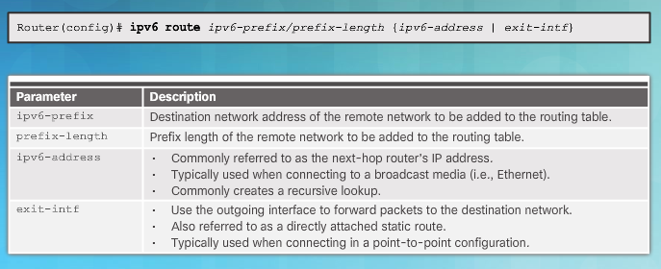
Configure IPv6 Static Routes The ipv6 route Command
Notes:
2.2 – Configure Static and Default Routes
2.2.3 – Configure IPv6 Static Routes
2.2.3.1 – The ipv6 route Command

Slide 40
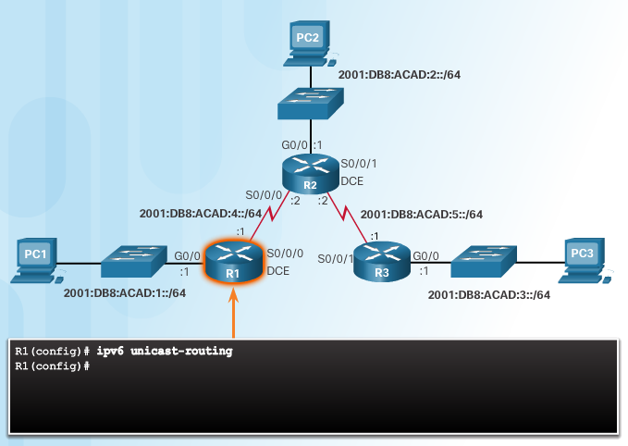
Configure IPv6 Static Routes The ipv6 route Command (Cont.)
ipv6 unicast-routing enables the router to forward IPv6 packets
Notes:
2.2 – Configure Static and Default Routes
2.2.3 – Configure IPv6 Static Routes
2.2.3.1 – The ipv6 route Command

Slide 41
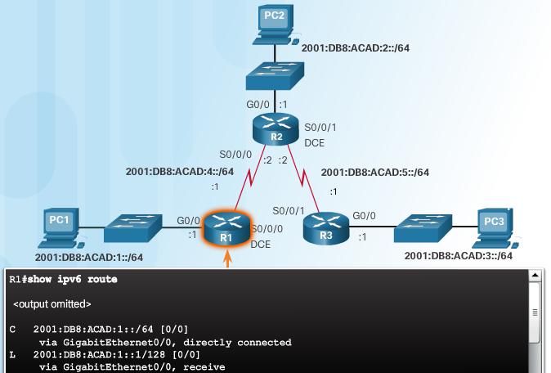
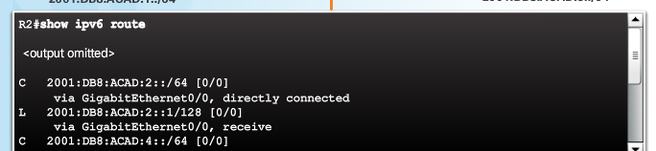
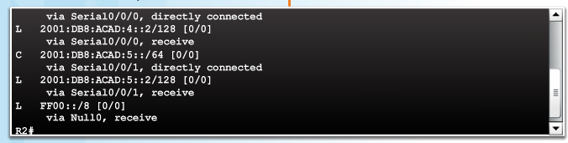
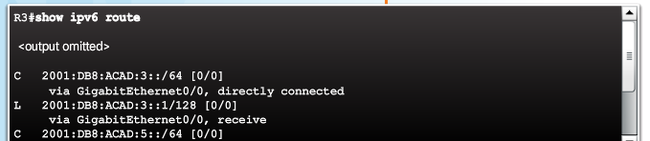
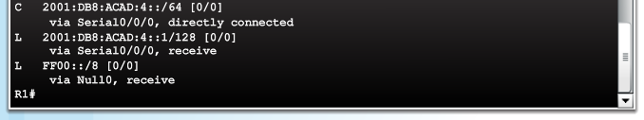
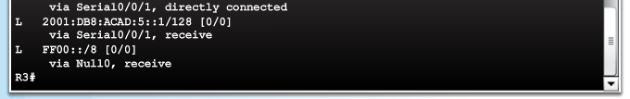
Configure IPv6 Static Routes Next-Hop Options
Each router only knows about directly connected networks
R1 can ping R2 (ipv6 2001:DB8:ACAD:4::2) but cannot ping R3 (ipv6 2001:DB8:ACAD:3::2)
Notes:
2.2 – Configure Static and Default Routes
2.2.3 – Configure IPv6 Static Routes
2.2.3.2 – Next-Hop Options

Slide 42
Configure IPv6 Static Routes Next-Hop Options (Cont.)
Next hop can be identified by an IPv6 address, exit interface, or both.
Destination is specified by one of three route types:
Next-hop static IPv6 route - Only the next-hop IPv6 address is specified
Directly connected static IPv6 route - Only the router exit interface is specified
Fully specified static IPv6 route - The next-hop IPv6 address and exit interface are specified
Notes:
2.2 – Configure Static and Default Routes
2.2.3 – Configure IPv6 Static Routes
2.2.3.2 – Next—Hop Options

Slide 43
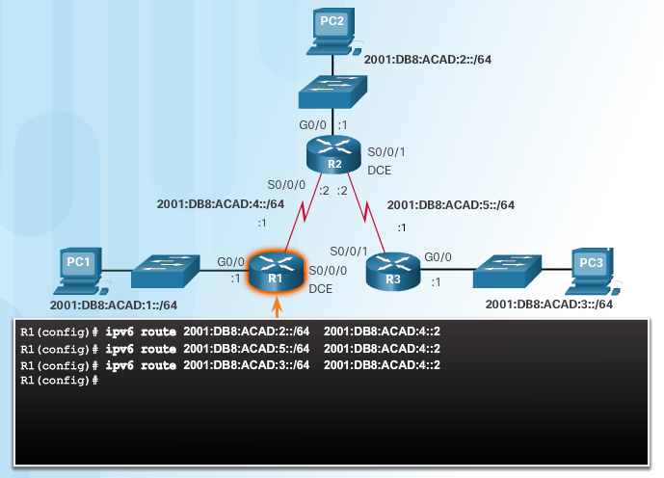
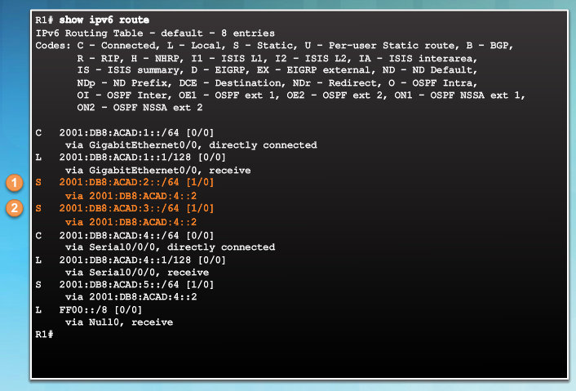
Configure IPv6 Static Routes Configure a Next Hop Static IPv6 Route
As with IPv4, must resolve the route to determine the exit interface to use to forward the packet
Three next-hop static routes are configured on R1
The IPv6 address matches the route for the directly connected network 2001:DB8:ACAD:4::/64 with the exit interface Serial 0/0/0.
Notes:
2.2 – Configure Static and Default Routes
2.2.3 – Configure IPv6 Static Routes
2.2.3.3 – Configure a Next Hop Static IPv6 Route

Slide 44
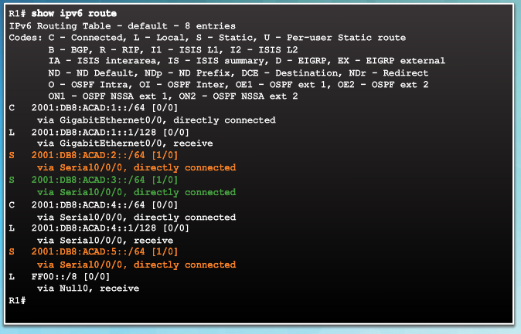
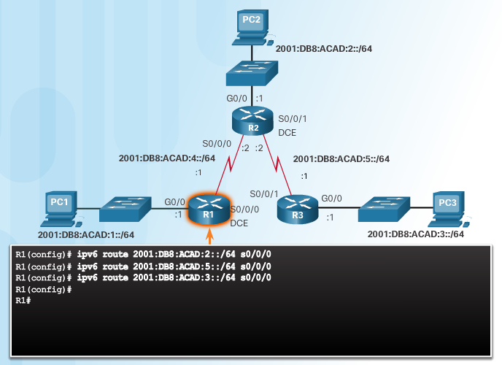
Configure IPv6 Static Routes Configure a Directly Connected Static IPv6 Route
Alternative to next hop is to specify the exit interface
Packet destined for 2001:DB8:ACAD:3::/64 network, forwarded out Serial 0/0/0 – no other lookups needed
Notes:
2.2 – Configure Static and Default Routes
2.2.3 – Configure IPv6 Static Routes
2.2.3.4 – Configure a Directly Connected Static IPv6 Route

Slide 45
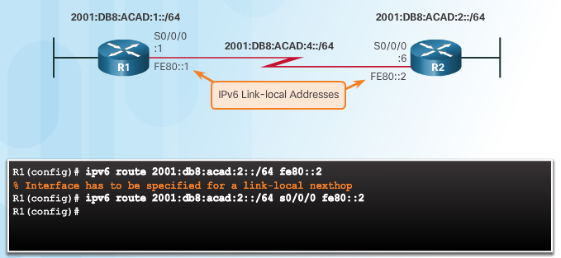
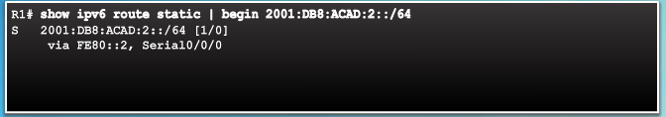
Configure IPv6 Static Routes Configure a Fully Specified Static IPv6 Route
Fully specified static route must be used if IPv6 link-local address is used as next-hop
Notes:
2.2 – Configure Static and Default Routes
2.2.3 – Configure IPv6 Static Routes
2.2.3.5 – Configure a Fully Specified Static IPv6 Route

Slide 46
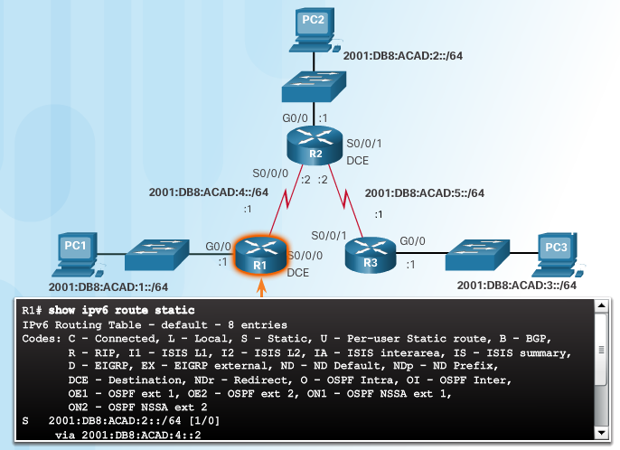
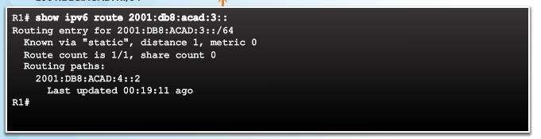
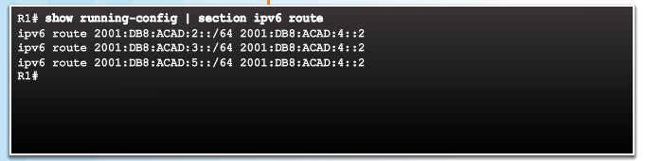

Configure IPv6 Static Routes Verify IPv6 Static Routes
Notes:
2.2 – Configure Static and Default Routes
2.2.3 – Configure IPv6 Static Routes
2.2.3.6 – Verify IPv6 Static Routes

Slide 47
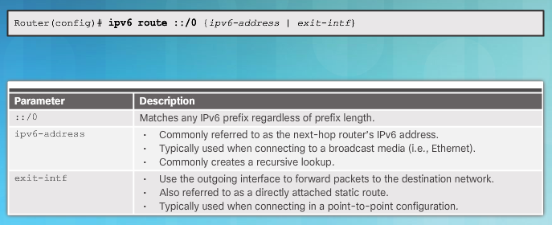
Configure IPv6 Default Routes Default Static IPv6 Route
Default static route matches all packets not specified in routing table
Notes:
2.2 – Configure Static and Default Routes
2.2.4 – Configure IPv6 Default Routes
2.2.4.1 – Default Static IPv6 Route

Slide 48
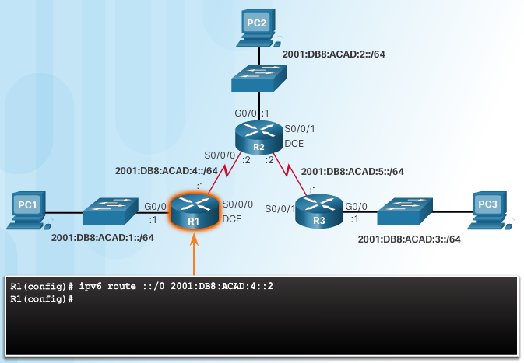
Configure IPv6 Default Routes Configure a Default Static IPv6 Route
R1 is a stub router because it is only connected to R2
More efficient to configure a default static IPv6 route in this topology
Notes:
2.2 – Configure Static and Default Routes
2.2.4 – Configure IPv6 Default Routes
2.2.4.2 – Configure a Default Static IPv6 Route

Slide 49
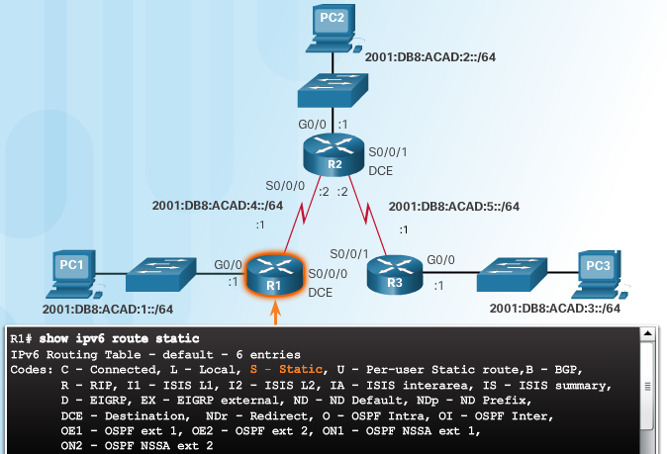


Configure IPv6 Default Routes Verify a Default Static Route
::/0 mask indicates that none of the bits are required to match
If a more specific match does not exist, the default static IPv6 route matches all packets.
Notes:
2.2 – Configure Static and Default Routes
2.2.4 – Configure IPv6 Default Routes
2.2.4.3 – Verify a Default Static Route

Slide 50
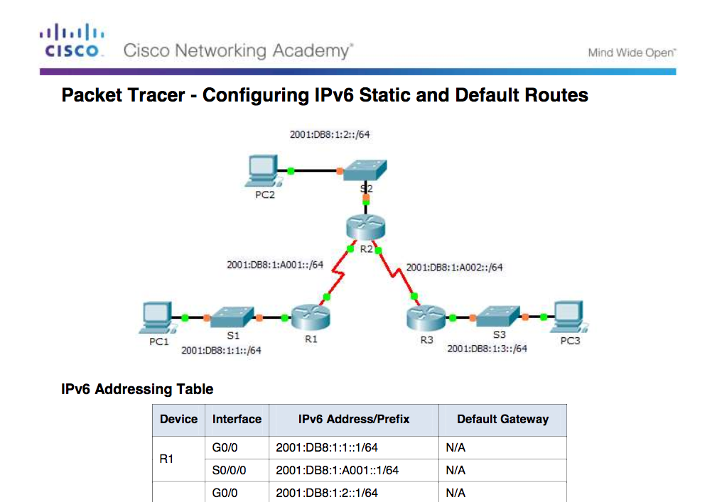
Configure IPv6 Default Routes Packet Tracer – Configuring IPv6 Static and Default Routes
Notes:
2.2 – Configure Static and Default Routes
2.2.4 – Configure IPv6 Default Routes
2.2.4.4 – Packet Tracer – Configuring IPv6 Static and Default Routes

Slide 51

Configure IPv6 Default Routes Lab – Configuring IPv6 Static and Default Routes
Notes:
2.2 – Configure Static and Default Routes
2.2.4 – Configure IPv6 Default Routes
2.2.4.5 – Lab – Configuring IPv6 Static and Default Routes

Slide 52

Configure Floating Static Routes Floating Static Routes
Floating static routes have an administrative distance greater than the dynamic routing protocol or other static route
Used as backup routes
Administrative distance of common routing protocols
EIGRP = 90
IGRP = 100
OSPF = 110
IS-IS = 115
RIP = 120
By default, AD of static route = 1
Static route AD can be increased to make route less desirable until preferred route is lost
Notes:
2.2 – Configure Static and Default Routes
2.2.5 – Configure Floating Static Routes
2.2.5.1 – Floating Static Routes

Slide 53


Configure Floating Static Routes Configure a Floating Static Route
Preferred router from R1 is to R2 (AD = 1)
Notes:
2.2 – Configure Static and Default Routes
2.2.5 – Configure Floating Static Routes
2.2.5.2 – Configure an IPv4 Floating Static Route

Slide 54


Configure Floating Static Routes Test the IPv4 Floating Static Route
Notes:
2.2 – Configure Static and Default Routes
2.2.5 – Configure Floating Static Routes
2.2.5.3 – Test the IPv4 Floating Static Route

Slide 55


Configure Floating Static Routes Test the IPv4 Floating Static Route (Cont.)
Notes:
2.2 – Configure Static and Default Routes
2.2.5 – Configure Floating Static Routes
2.2.5.3 – Test the IPv4 Floating Static Route

Slide 56



Configure Floating Static Routes Configure an IPv6 Floating Static Route
Similar to IPv4 floating static routes
Notes:
2.2 – Configure Static and Default Routes
2.2.5 – Configure Floating Static Routes
2.2.5.4 –Configure an IPv6 Floating Static Route

Slide 57

Configure Floating Static Routes Packet Tracer - Configuring Floating Static Routes
Notes:
2.2 – Configure Static and Default Routes
2.2.5 – Configure Floating Static Routes
2.2.5.5 –Packet Tracer - Configuring Floating Static Routes

Slide 58


Configure Static Host Routes Automatically Installed Host Routes
Host route is an IPv4 address with a 32-bit mask or IPv6 address with a 128-bit mask.
Automatically installed when IP address is configured
Configured as a static host route
Allows more efficiency for packets directed to the router
Local route marked with “L” (introduced in IOS 15)
Notes:
2.2 – Configure Static and Default Routes
2.2.6 – Configure Static Host Routes
2.2.6.1 – Automatically Installed Host Routes

Slide 59



Configure Static Host Routes Configure IPv4 and IPv6 Static Host Routes
Notes:
2.2 – Configure Static and Default Routes
2.2.6 – Configure Static Host Routes
2.2.6.2 – Configure IPv4 and IPv6 Static Host Routes

Slide 60
2.3 Troubleshoot Static and Default Routes
Notes:
2 - Static Routing
2.3 – Troubleshoot Static and Default Routes

Slide 61


Packet Processing with Static Routes Static Routes and Packet Forwarding
PC1 sending packet to PC3 - Packet arrives on G0/0
R1 has no specific route to 192.168.2.0 so uses default route
R1 encapsulates packet in new frame
Frame forwarded out S0/0/0
Notes:
2.3 – Troubleshoot Static and Default Routes
2.3.1 – Packet Processing with Static Routes
2.3.1.1 – Static Routes and Packet Forwarding

Slide 62


Packet Processing with Static Routes Static Routes and Packet Forwarding (Cont.)
R2 de-encapsulates the frame and looks for a route to the destination
Packet arrives on S0/0/0 interface on R2
R2 has a static route to 192.168.2.0/24 out the Serial 0/0/1 interface
R2 encapsulates the packet in a new frame and forwards out S0/0/1
Notes:
2.3 – Troubleshoot Static and Default Routes
2.3.1 – Packet Processing with Static Routes
2.3.1.1 – Static Routes and Packet Forwarding

Slide 63

Packet Processing with Static Routes Static Routes and Packet Forwarding (Cont.)
R3 de-encapsulates the frame and sees a connected route to 192.168.2.0/24 out G0/0
R3 looks up the ARP table entry for 192.168.2.10 to find the Layer 2 MAC address for PC3 (ARP used if needed for PC3 MAC)
R3 encapsulates the packet in a new frame with the MAC address of the G0/0 interface as the source Layer 2 address and the MAC address of PC3 as the destination MAC address
Frame is forwarded out of G0/0 interface and packet arrives on the NIC interface of PC3
Notes:
2.3 – Troubleshoot Static and Default Routes
2.3.1 – Packet Processing with Static Routes
2.3.1.1 – Static Routes and Packet Forwarding

Slide 64

Troubleshoot IPv4 Static and Default Route Configuration Troubleshoot a Missing Route
Common IOS troubleshooting commands include:
ping
traceroute
show ip route
show ip interface brief
show cdp neighbors detail
Notes:
2.3 – Troubleshoot Static and Default Routes
2.3.2 – Troubleshoot IPv4 Static and Default Route Configuration
2.3.2.1 – Troubleshoot a Missing Route

Slide 65






Troubleshoot IPv4 Static and Default Route Configuration Troubleshoot a Missing Route (Cont.)
Notes:
2.3 – Troubleshoot Static and Default Routes
2.3.2 – Troubleshoot IPv4 Static and Default Route Configuration
2.3.2.1 – Troubleshoot a Missing Route

Slide 66


Troubleshoot IPv4 Static and Default Route Configuration Solve a Connectivity Problem
A traceroute reveals that R2 forwards the traceroute back to R1. R1 returns it to R2
Notes:
2.3 – Troubleshoot Static and Default Routes
2.3.2 – Troubleshoot IPv4 Static and Default Route Configuration
2.3.2.2 – Solve a Connectivity Problem

Slide 67




Troubleshoot IPv4 Static and Default Route Configuration Solve a Connectivity Problem (Cont.)
Static route to 192.168.2.0/24 has been configured using the next-hop address 172.16.2.1.
Incorrect route is removed and the correct route is then entered
Notes:
2.3 – Troubleshoot Static and Default Routes
2.3.2 – Troubleshoot IPv4 Static and Default Route Configuration
2.3.2.2 – Solve a Connectivity Problem

Slide 68

Troubleshoot IPv4 Static and Default Route Configuration Packet Tracer – Troubleshooting Static Routes
Notes:
2.3 – Troubleshoot Static and Default Routes
2.3.2 – Troubleshoot IPv4 Static and Default Route Configuration
2.3.2.3 – Packet Tracer – Troubleshooting Static Routes

Slide 69

Troubleshoot IPv4 Static and Default Route Configuration Lab – Troubleshooting Static Routes
Notes:
2.3 – Troubleshoot Static and Default Routes
2.3.2 – Troubleshoot IPv4 Static and Default Route Configuration
2.3.2.4 – Lab – Troubleshooting Static Routes

Slide 70
2.4 Chapter Summary
Notes:
2 - Static Routing
2.4 – Summary

Slide 71
Conclusion Chapter 2: Static Routing
Explain how static routes are implemented in a small to medium-sized business network.
Configure static routes to enable connectivity in a small to medium-sized business network.
Troubleshoot static and default route configurations.
Notes:
2.4 – Summary
2.4.1 – Conclusion
2.4.1.2 – Chapter 2: Static Routing

Slide 72
Section 2.1 New Terms and Commands
stub network stub router Standard static route | Summary static route Floating static route exit interface
Notes:
New Terms and Commands

Slide 73
Section 2.2 New Terms and Commands
next-hop IP address next-hop static route directly connected static route fully specified static route | recursive lookup link-local address host route local host route
Notes:
New Terms and Commands

